Slide 1

Flux
Flux
Patrick Donelan
WUC – Madison - 2008
pat@patspam.com http://patspam.com

Slide 2
Flux
a.k.a
Improving the WebGUI Authorization
layer
Patrick Donelan
WUC – Madison - 2008
pat@patspam.com http://patspam.com

Slide 3
Flux
a.k.a
How can we make WebGUI
sites more dynamic
($we !~ /developers/)
Patrick Donelan
WUC – Madison - 2008
pat@patspam.com http://patspam.com

Slide 4
Flux
How can we make it possible for content managers to make their WebGUI sites more dynamic without hiring more developers
Patrick Donelan
WUC – Madison - 2008
pat@patspam.com http://patspam.com

Slide 5
Flux
How can we make clients and end users do most of the work for us
Patrick Donelan
WUC – Madison - 2008
pat@patspam.com http://patspam.com

Slide 6
Flux
(following the grand tradition started by
Thingy and Survey2)
Patrick Donelan
WUC – Madison - 2008
pat@patspam.com http://patspam.com

Slide 7
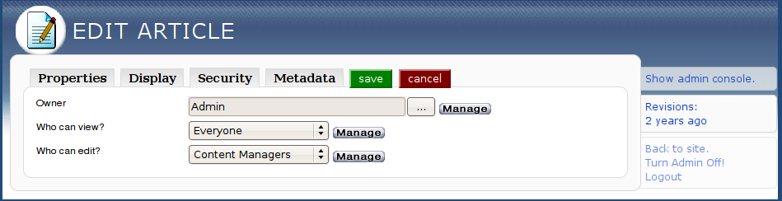
Flux
Lets us choose the Group that a user must belong to to perform this action
“Group Based Authorization”

Slide 8
Flux
Group Based Authorization
You're either in the Group
    action allowed !
Or you're not in the Group
    action denied!

Slide 9
Flux
How developers use the Group API:
$user->isInGroup()
$group->getUsers()
$group->getIpUsers()
$group->getKarmaUsers()
$group->getLDAPUsers()
$group->getScratchUsers()

Slide 10
Flux
What other sorts of dynamic rules might we want?
Time-based?
User Profile-based?
User History-based?
User Content-based?
Anything-based!

Slide 11
Flux
Flux:
Rule-based Authorization layer for wG
Allows Content Managers to create Rules through a simple, intuitive GUI
Allows developers to create plugins so that Rules can test against anything they like

Slide 12
Flux
Whirlwind tour..

Slide 13
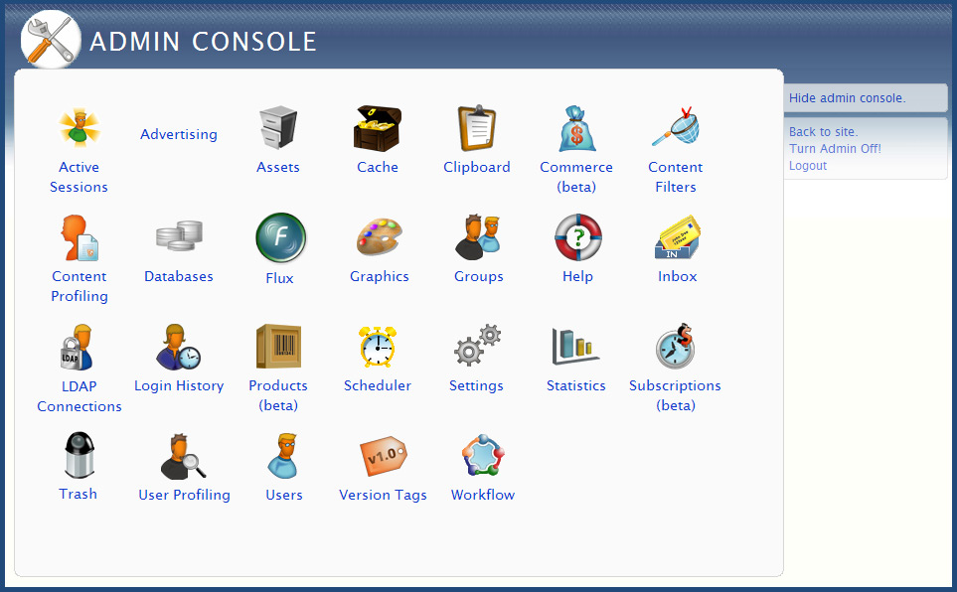
Flux

Slide 14
Flux
..end of the tour

Slide 15
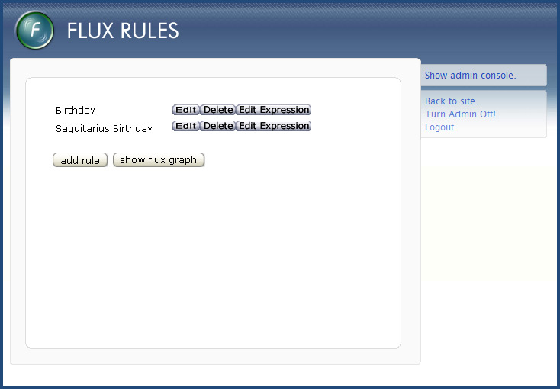
Flux

Slide 16
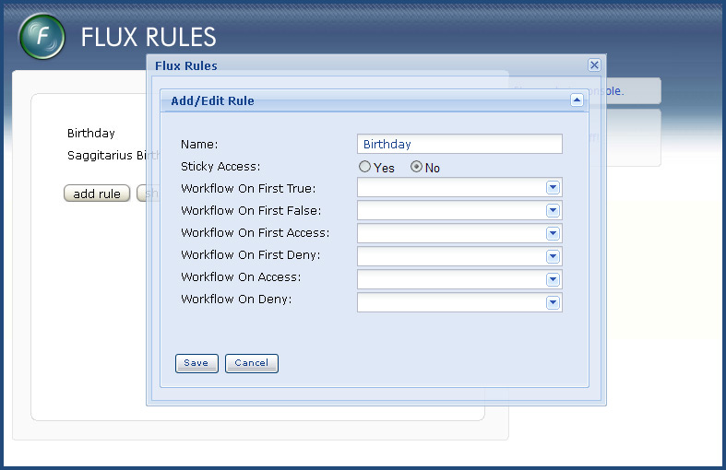
Flux

Slide 17
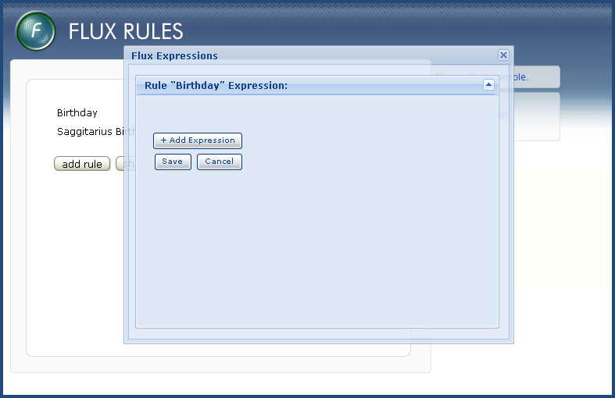
Flux

Slide 18
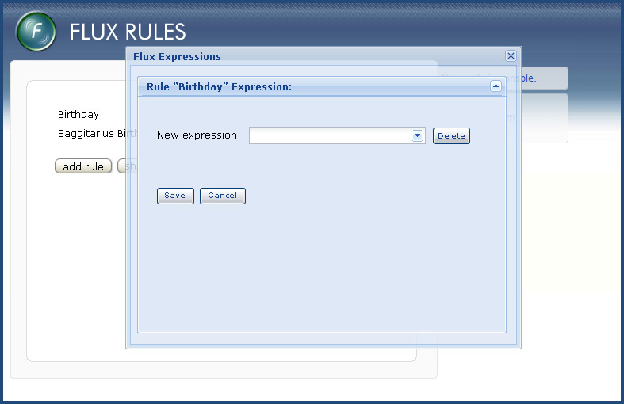
Flux

Slide 19
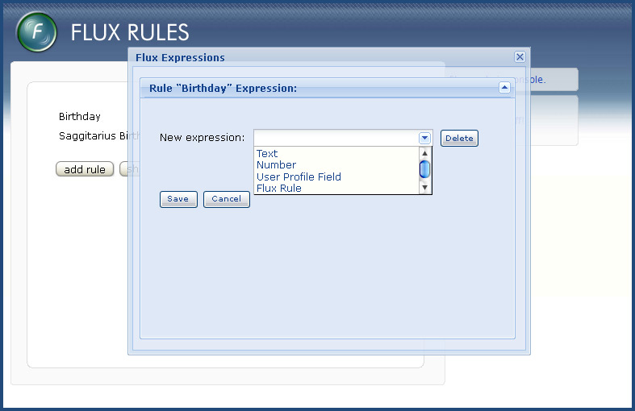
Flux

Slide 20
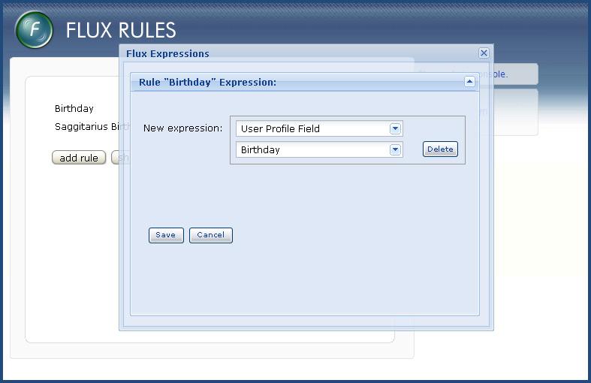
Flux

Slide 21
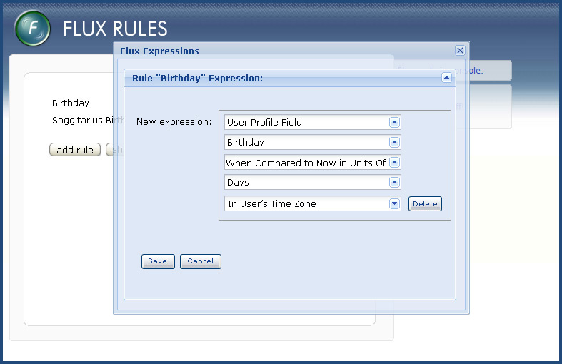
Flux

Slide 22
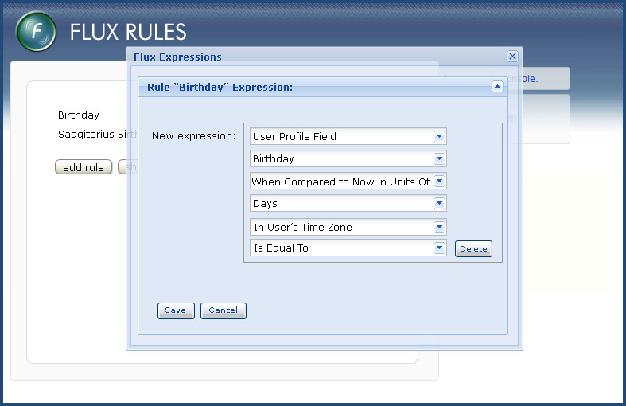
Flux

Slide 23
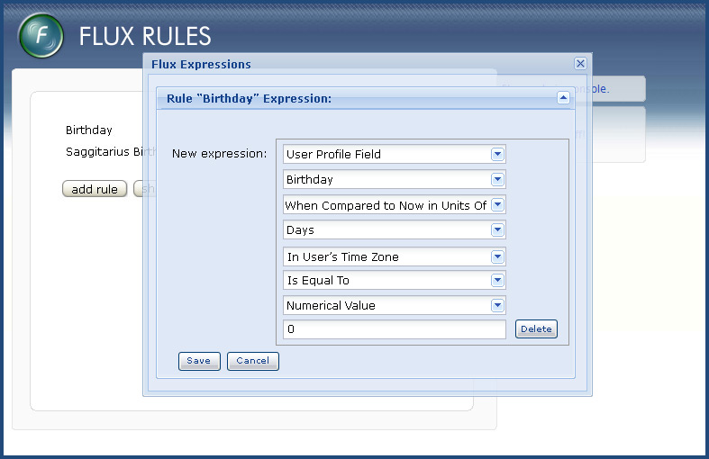
Flux

Slide 24
Flux
Features
Modular design
  Rule: Expression+
  Expression: Operand1 Operator Operand2
  Operand: Any sort of value you like, from a bundled Flux Operand or your own plugin
  Operator: =, >, <, >=, <=, m//, ..
  Modifier: Handle complex data types
  (all modular and extensible via plugins)

Slide 25
Flux
Features
Workflow Triggers
  e.g. Email a user when a new page becomes available

Slide 26
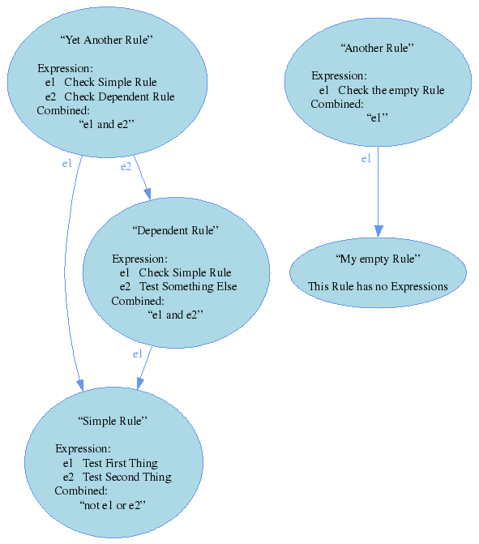
Flux
Features
Rule dependencies
  eye-candy!

Slide 27
Flux
“Anything” also includes..
  Group-based Authorization :)

Slide 28
Flux
Current Status
191 tests, 87% test coverage
Currently being used in the development of 2 large, complex sites but not yet in production
Fully functional but currently missing some parts of the friendly GUI for content managers
Work ongoing but on track for inclusion in the WebGUI core in some future major release

Slide 29
Flux
Bonus Demo
Patrick Donelan
WUC – Madison - 2008
pat@patspam.com http://patspam.com

Slide 30
Flux
Each question is an article
contains a form element that submits to a cookie
Simple (~1 line) Flux Plugin to return cookie value
return $self->session->http->getCookies()->{$cookie_name};
Flux Rule controls article view order

Slide 31
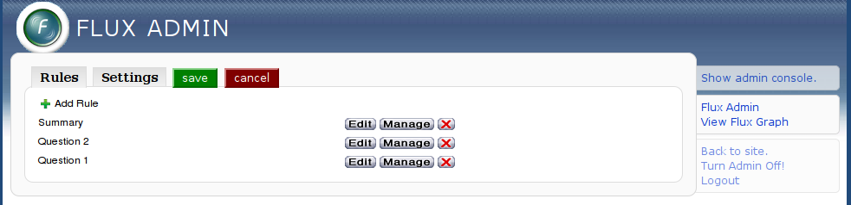
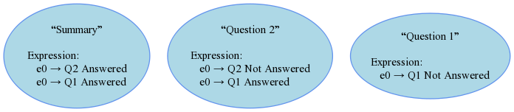
Flux

Slide 32
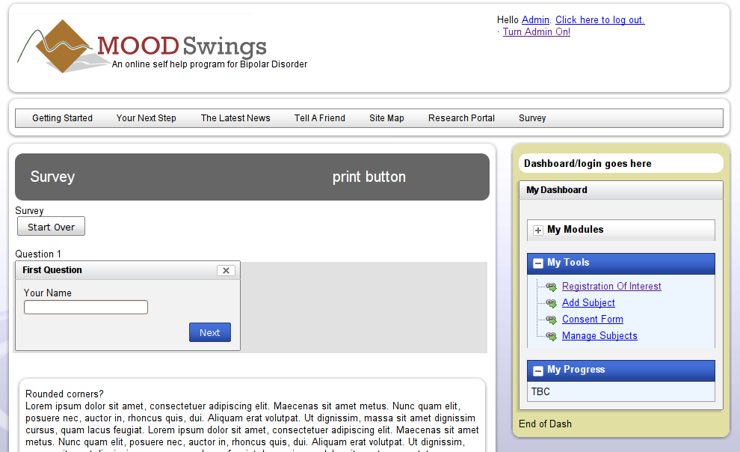
Flux

Slide 33
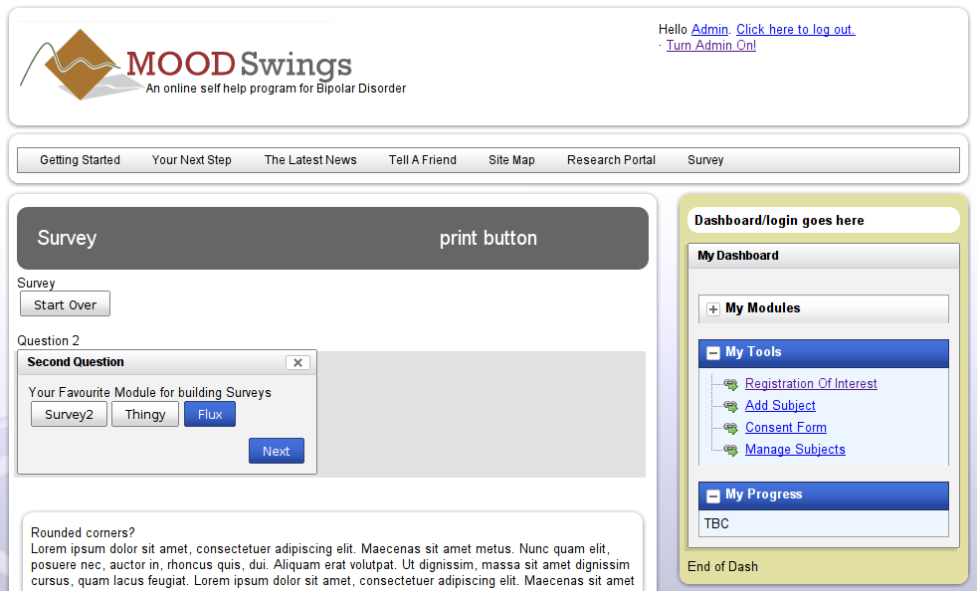
Flux

Slide 34
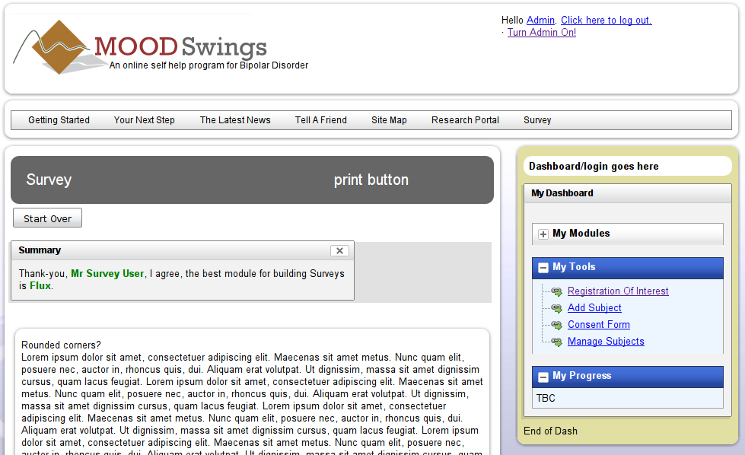
Flux

Slide 35
Flux
More Info
https://svn.webgui.org/plainblack/branch/WebGUI_flux
  See /fluxdesigndocs in SVN for full spec document
http://www.patspam.com

Slide 36

Flux
The End

